Slide 1




My Algebra Interactive Notebook
$$3ab$$
$$2x+3y$$
$$\frac{5xy}{6}$$
Name :
Class :
Term 2 Semester 1
$$y=2x+1$$

Slide 2
Contents
Glossary
Page
Date
Description
2
3

Slide 3
Tasks
24
7
30
Essential Question
Questions
Notes
Summary
4
7

Slide 4
24
7
30
Date
Expanding Perfect Squares
EQ – How do I expand a squared expression?
How do I use the table method?

Slide 5

24
7
30
Date
Expanding Binomial Expressions
EQ – How do I expand two brackets?
How do I use the table method?
Expand ${ (a+b) }^{2}$

Slide 6
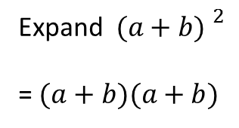
24
7
30
Date
Expanding Binomial Expressions
EQ – How do I expand two brackets?
How do I use the table method?
Expand ${ (a+b) }^{2}$
= $(a+b)(a+b)$

Slide 7
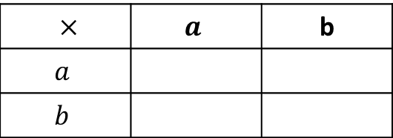
24
7
30
Date
Expanding Binomial Expressions
EQ – How do I expand two brackets?
How do I use the table method?
Expand ${ (a+b) }^{2}$
= $(a+b)(a+b)$
$×$ | $$a$$ | b
$$a$$
$$b$$

Slide 8
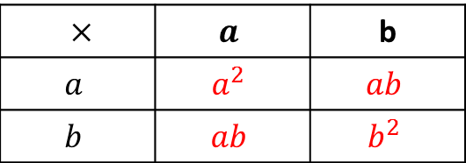
24
7
30
Date
Expanding Binomial Expressions
EQ – How do I expand two brackets?
How do I use the table method?
Expand ${ (a+b) }^{2}$
= $(a+b)(a+b)$
$×$ | $$a$$ | b
$$a$$ | $$a^{2}$$ | $$ab$$
$$b$$ | $$ab$$ | $$b^{2}$$

Slide 9
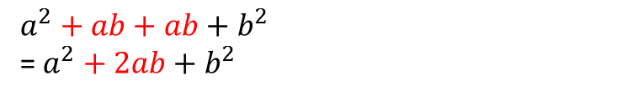
24
7
30
Date
Expanding Binomial Expressions
EQ – How do I expand two brackets?
How do I use the table method?
Expand ${ (a+b) }^{2}$
= $(a+b)(a+b)$
$×$ | $$a$$ | b
$$a$$ | $$a^{2}$$ | $$ab$$
$$b$$ | $$ab$$ | $$b^{2}$$
$$a^{2}+ab+ab+b^{2}$$
= $a^{2}+2ab+b^{2}$

Slide 10
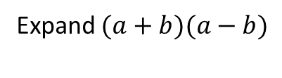

24
7
30
Date
Expanding Binomial Expressions
EQ – How do I expand two brackets?
How do I use the table method?
Expand ${ (a+b) }^{2}$
= $(a+b)(a+b)$
$×$ | $$a$$ | b
$$a$$ | $$a^{2}$$ | $$ab$$
$$b$$ | $$ab$$ | $$b^{2}$$
$$a^{2}+ab+ab+b^{2}$$
= $a^{2}+2ab+b^{2}$
Expand $(a+b)(a−b)$

Slide 11
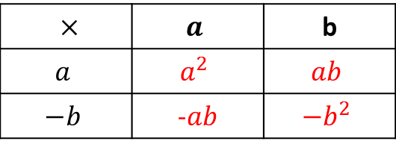
24
7
30
Date
Expanding Binomial Expressions
EQ – How do I expand two brackets?
How do I use the table method?
Expand ${ (a+b) }^{2}$
= $(a+b)(a+b)$
$×$ | $$a$$ | b
$$a$$ | $$a^{2}$$ | $$ab$$
$$b$$ | $$ab$$ | $$b^{2}$$
$$a^{2}+ab+ab+b^{2}$$
= $a^{2}+2ab+b^{2}$
$×$ | $$a$$ | b
$$a$$ | $$a^{2}$$ | $$ab$$
$$−b$$ | -$ab$ | $${−b}^{2}$$
Expand $(a+b)(a−b)$

Slide 12
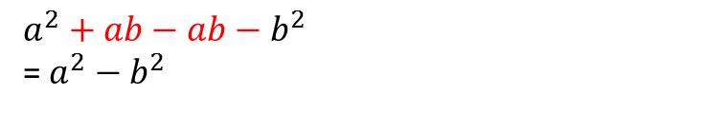
24
7
30
Date
Expanding Binomial Expressions
EQ – How do I expand two brackets?
How do I use the table method?
Expand ${ (a+b) }^{2}$
= $(a+b)(a+b)$
$×$ | $$a$$ | b
$$a$$ | $$a^{2}$$ | $$ab$$
$$b$$ | $$ab$$ | $$b^{2}$$
$$a^{2}+ab+ab+b^{2}$$
= $a^{2}+2ab+b^{2}$
$×$ | $$a$$ | b
$$a$$ | $$a^{2}$$ | $$ab$$
$$−b$$ | -$ab$ | $${−b}^{2}$$
Expand $(a+b)(a−b)$
$$a^{2}+ab−ab−b^{2}$$
= $a^{2}−b^{2}$

Slide 13
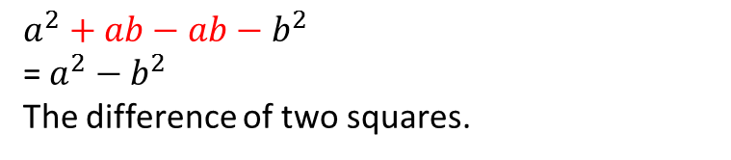
24
7
30
Date
Expanding Binomial Expressions
EQ – How do I expand two brackets?
How do I use the table method?
Expand ${ (a+b) }^{2}$
= $(a+b)(a+b)$
$×$ | $$a$$ | b
$$a$$ | $$a^{2}$$ | $$ab$$
$$b$$ | $$ab$$ | $$b^{2}$$
$$a^{2}+ab+ab+b^{2}$$
= $a^{2}+2ab+b^{2}$
$×$ | $$a$$ | b
$$a$$ | $$a^{2}$$ | $$ab$$
$$−b$$ | -$ab$ | $${−b}^{2}$$
Expand $(a+b)(a−b)$
$$a^{2}+ab−ab−b^{2}$$
= $a^{2}−b^{2}$
The difference of two squares.

Slide 15
Homework
Review your notes and write a summary answering the essential question.

